Slide 1

Instructions for
Programming Assignment 2
[CSED233-01] 2023 Spring, Data Structure
Seunguk Do Suhyeon Jeong Minjae Jeong Sangjun Lee Jaesik Park

Slide 2
Overview
Programming Assignment Guidance
How to submit your code

Slide 3
Programming Assignment Guidance

Slide 4
Overall process
Provided for the students
pa2.cpp
evaluate.cpp
NOT provided for the students
void task1() {
//do something
}
void task2() {
// implement code
}
don’t change anything here
/*
read answer.txt
read submit.txt
then compare
*/
real_test cases
real answer.txt
compile & execution
compile & execution
this will be your actual score :)
answer.txt
submit.txt
compare &
tell your score
[Task1]
…
[Task2]
…
[Task1]
…
[Task2]
…
you can self-check if your implementations are correct with the provided files

Slide 5
Programming Assignment 2 guidance
Change your answer in pa2.cpp for task 1.
Implement your code at tree.cpp, heap.cpp, tree.h, heap.h for remaining tasks.
You are not allowed to change pa2.cpp except those two lines for task 1.
And you are not allowed to change the other files: utils.h, utils.cpp, evaluate.cpp

Slide 6
Programming Assignment guidance
5. When you are done, compile and run pa2.exe
Repl.it user: type as below in terminal
CLion user: type as below in terminal, refer to the link for opening the terminal
** note that you need to specify the compiler version to 11 by -std=c++11

Slide 7
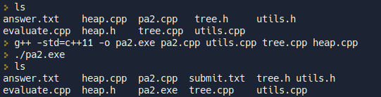
Programming Assignment guidance
6. Step5 will generate submit.txt file which contains your answer
Repl.it
CLion: submit.txt file will be generated in [cmake-build-debug] folder
< running this will generate pa2.exe
< running this will generate submit.txt

Slide 8
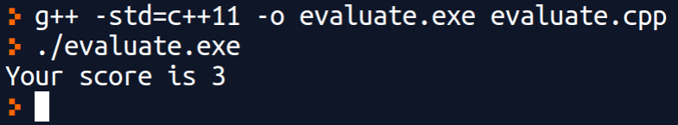
Programming Assignment guidance
7. check your score by running evaluate.cpp file. This will compare your answer submit.txt with the provided answer answer.txt.
Repl.it & CLion
note that this is not your actual score since we might use other test cases from what we’ve provided

Slide 9
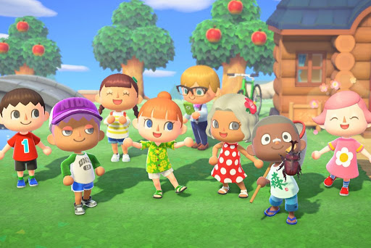
Try TODAY!
Even if the process looks not familiar to you, that is normal.
If you are not sure, please use Q&A or discuss it with your friends.
Animal Crossing, © Nintendo

Slide 10
How to submit your work

Slide 11
Via POSTECH-LMS
Go to PLMS(https://plms.postech.ac.kr/) → CSED233-01 → Learning activity → assignments
Put your pa2.cpp, tree.cpp, tree.h, heap.cpp, heap.h file and pa2.exe in single folder and compress it into a zip file
The name of zip file should be : studentNumber_YourName.zip (e.g : 20231234_HongGildong.zip)
Submit your zip file!
Please be aware... we won’t accept email submissions

Slide 12
Q&A

